Slide 1


Data Structure
Course Code : ENCS205
Dr Swati Gupta
Associate Professor, School of Engineering & Technology
K.R. Mangalam University
Unit 4 :Trees and Graphs
Notes:
New Courses replaced with New Programmes

Slide 2

BINARY SEARCH TREES
Session 48
Introduction to Binary Search Tree
Properties of BST
Constructing BST
Operations on BST(Insertion of a Node)
Brainstorming Session
Notes:
New Courses replaced with New Programmes

Slide 3
RECAP
Traversal is the process of going through all nodes in the tree and printing the values.
Tree Data Structure can be traversed in following ways:
Inorder Traversal
Preorder Traversal
Postorder Traversal
Notes:
New Courses replaced with New Programmes

Slide 4
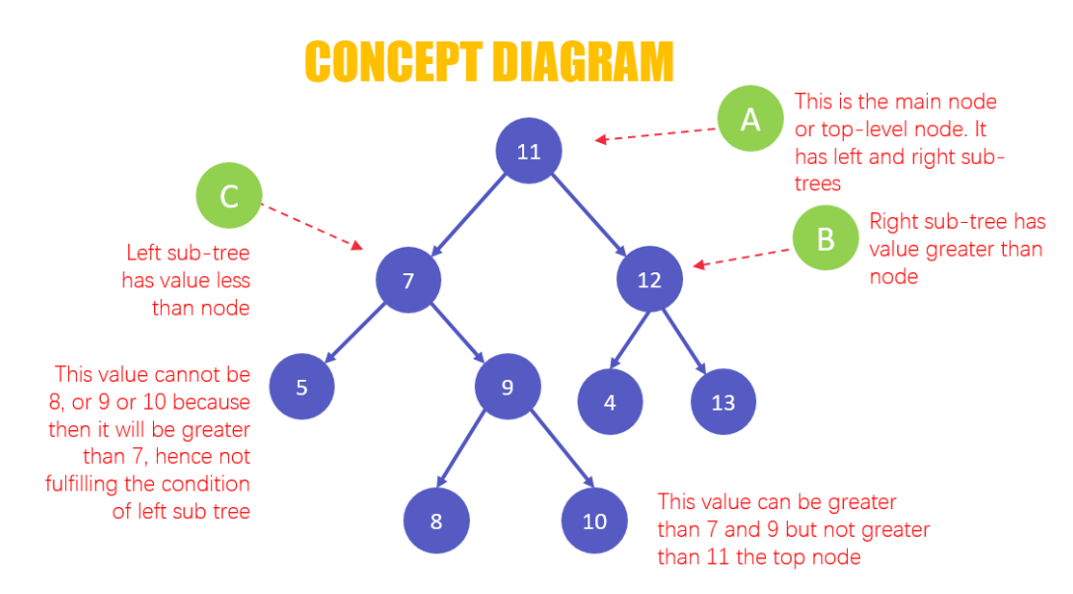
Binary Search Tree
A binary search tree(BST) is a special type of binary tree and is also known as a sorted or ordered binary tree.
In a binary search tree the two properties are obeyed:
The value of the left node is less than the value of the
parent node.
The value of the right node is greater than the value of the parent node.
Notes:
New Courses replaced with New Programmes

Slide 5
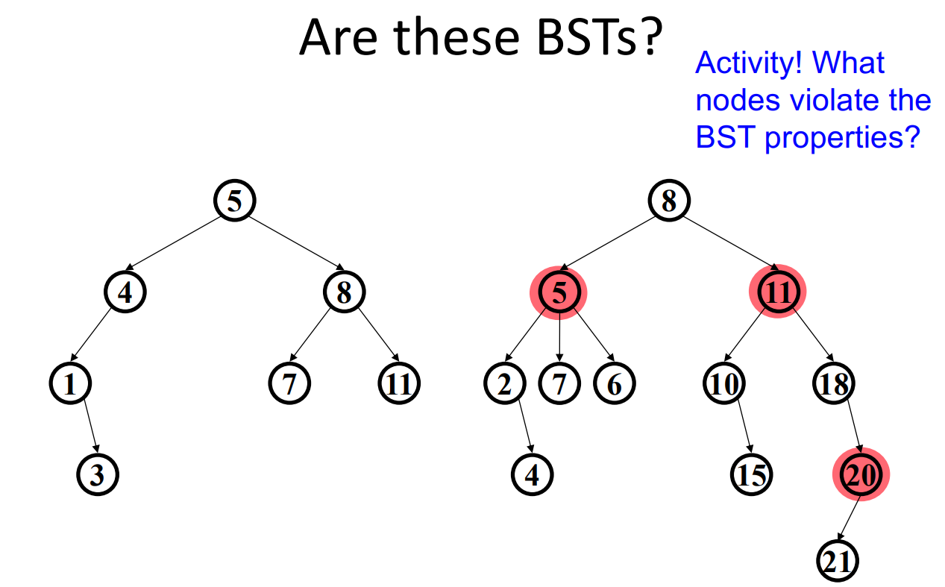
Binary Search Tree
Notes:
New Courses replaced with New Programmes

Slide 6
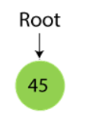
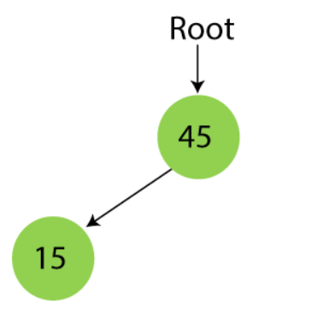
Creation of Binary Search Tree
Creating a BST by considering the following
data elements - 45, 15, 79, 90, 10, 55, 12, 20, 50
Step 1 - Insert 45. Step 2 - Insert 15.
As 15 is smaller than 45, so insert it as
the root node of the left subtree.
Notes:
New Courses replaced with New Programmes

Slide 7
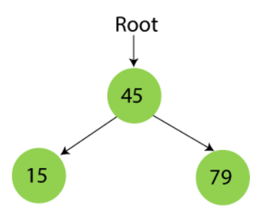
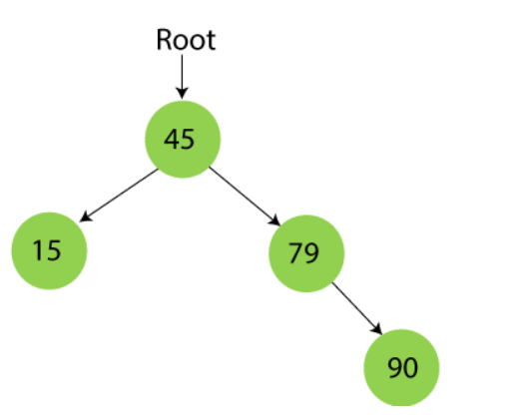
Creation of Binary Search Tree
Step 3 - Insert 79.
As 79 is greater than 45, so insert it as the root node of the right subtree.
Step 4 - Insert 90.
90 is greater than 45 and 79, so it will be inserted as the right subtree of 79.
Notes:
New Courses replaced with New Programmes

Slide 8
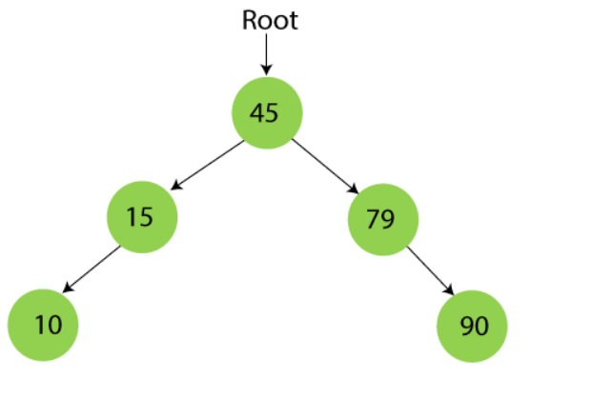
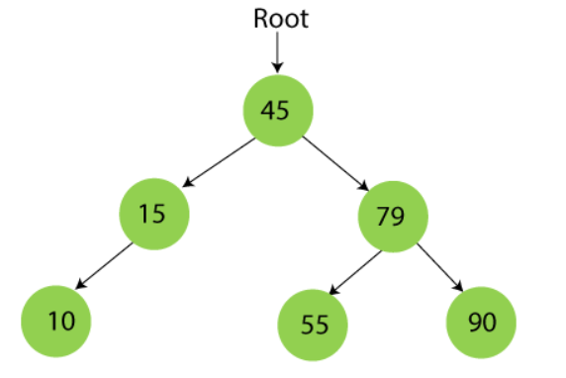
Creation of Binary Search Tree
Step 5 - Insert 10.
10 is smaller than 45 and 15, so it will be inserted as a left subtree of 15.
Step 6 - Insert 55.
55 is larger than 45 and smaller than 79, so it will be inserted as the left subtree of 79.
Notes:
New Courses replaced with New Programmes

Slide 9
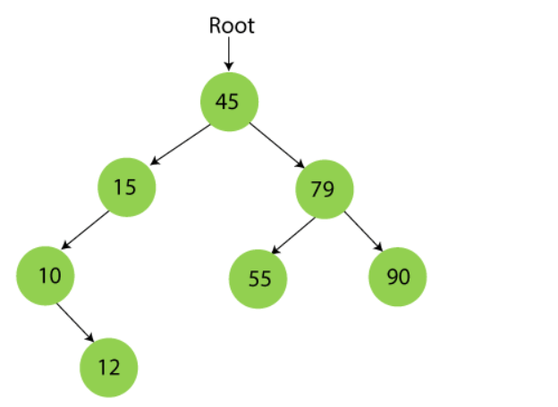
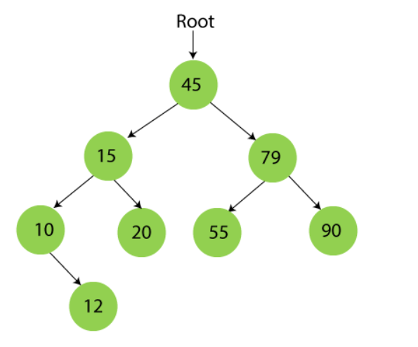
Creation of Binary Search Tree
Step 7- Insert 12.
12 is smaller than 45 and 15 but greater than 10, so it will be inserted as the right subtree of 10
Step 8 - Insert 20.
20 is smaller than 45 but greater than 15, so it will be inserted as the right subtree of 15.
Notes:
New Courses replaced with New Programmes

Slide 10
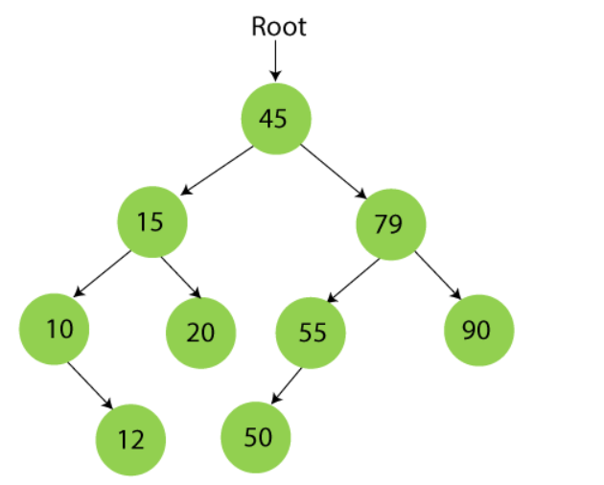
Creation of Binary Search Tree
Step 9 - Insert 50.
50 is greater than 45 but smaller than 79 and 55. So, it will be inserted as a left subtree of 55.
Notes:
New Courses replaced with New Programmes

Slide 11
Exercise : Binary Search Tree
Add the following values one at a time to an initially empty binary search tree and construct a Tree
50 90 20 78 10 20 28 25
Notes:
New Courses replaced with New Programmes

Slide 12
Applications of Binary Search Tree
Databases: Many databases use BSTs to store and search for data. For example, MySQL and SQLite use BSTs to store indexes of the data they contain, making queries much faster.
File Systems: File systems use BSTs to store and organize files on a hard drive. For example, the Windows NTFS file system uses BSTs to store the Master File Table (MFT), which contains information about all the files on the hard drive.
Computer Networks: BSTs can be used to store routing tables in computer networks. This allows routers to quickly find the best route for a packet to take from one network to another.
Notes:
New Courses replaced with New Programmes

Slide 13

Operations on Binary Search Tree
Searching a Node in BST
Insertion a new Node in BST
Deleting a Node in BST

Slide 14
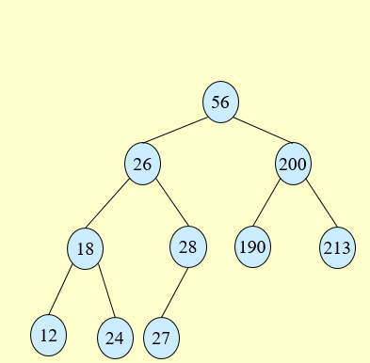
Searching a Node In BST : Algorithm
Tree-Search(x, k)
1. if x = NIL or k = key[x]
2. then return x
3. if k < key[x]
4. then return Tree-Search(left[x], k)
5. else return Tree-Search(right[x], k)
Notes:
New Courses replaced with New Programmes

Slide 15
Searching a Node In BST : Algorithm
Tree-Minimum(x) Tree-Maximum(x)
1. while left[x] ≠ NIL 1. while right[x] ≠ NIL
2. do x ← left[x] 2. do x ← right[x]
3. return x 3. return x
Notes:
New Courses replaced with New Programmes

Slide 16
Searching a Node In Binary Search Tree : Pseudo code
search Element(TREE, VAL)
Step 1: IF TREE->DATA = VAL OR TREE = NULL, then
Return TREE
ELSE
IF VAL < TREE->DATA
Return searchElement(TREE->LEFT, VAL)
ELSE
Return searchElement(TREE->RIGHT, VAL)
[END OF IF]
[END OF IF]
Step 2: End
Notes:
New Courses replaced with New Programmes

Slide 17
Searching a Node In Binary Search Tree : Pseudo code
search Element(TREE, VAL)
Step 1: IF TREE->DATA = VAL OR TREE = NULL, then
Return TREE
ELSE
IF VAL < TREE->DATA
Return searchElement(TREE->LEFT, VAL)
ELSE
Return searchElement(TREE->RIGHT, VAL)
[END OF IF]
[END OF IF]
Step 2: End
Notes:
New Courses replaced with New Programmes

Slide 18
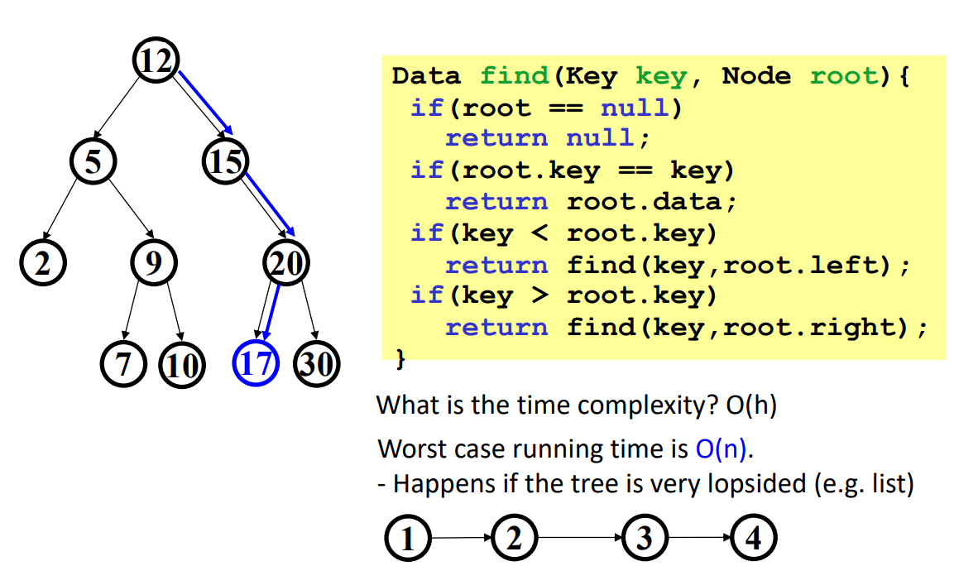
Searching a Node In Binary Search Tree :Recursive
Notes:
New Courses replaced with New Programmes

Slide 19
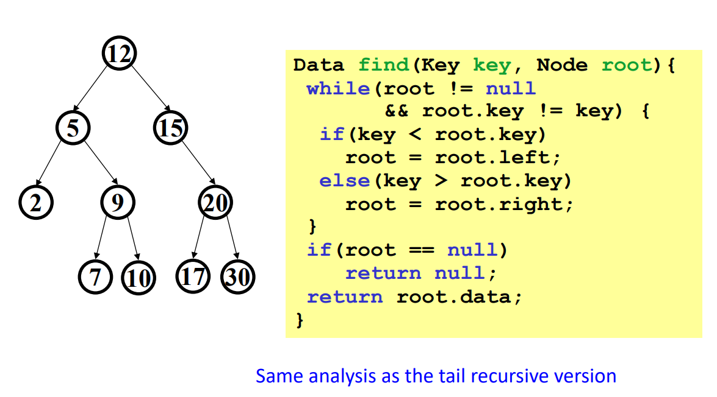
Searching a Node In Binary Search Tree : Iterative
Notes:
New Courses replaced with New Programmes

Slide 20
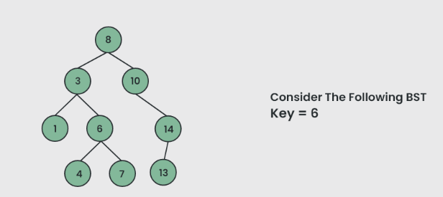
Searching a Node In Binary Search Tree : Example
Step 1: ITEM(KEY) to be searched = 6
Notes:
New Courses replaced with New Programmes

Slide 21
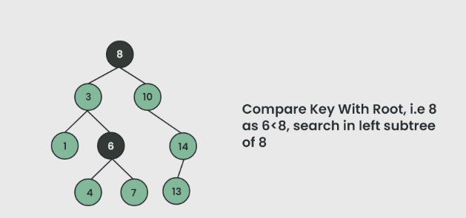
Searching a Node In Binary Search Tree : Example
Step 2: Compare the KEY with the ROOT
Notes:
New Courses replaced with New Programmes

Slide 22
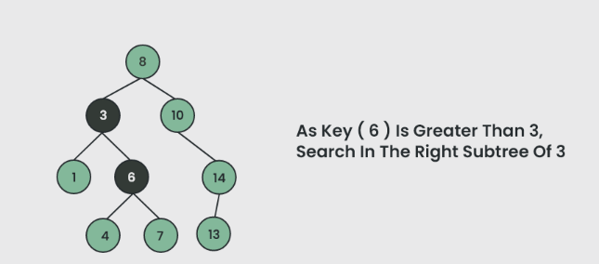
Searching a Node In Binary Search Tree : Example
Step 3: Compare the KEY with Parent Node 3
Notes:
New Courses replaced with New Programmes

Slide 23
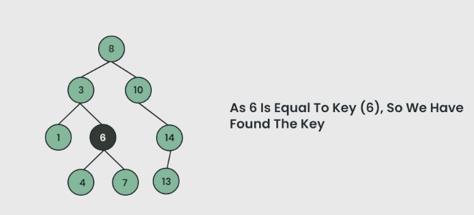
Searching a Node In Binary Search Tree : Example
Step 4: ITEM Found
Notes:
New Courses replaced with New Programmes

Slide 24
Test Your Knowledge
Q1 The following numbers are inserted into an empty binary search tree in the given order: 10, 1, 3, 5, 15, 12, 16. What is the height of the binary search tree (the height is the maximum distance of a leaf node from the root)?
(A) 2
(B) 3
(C) 4
(D) 6
Answer (B)
Q2 While inserting the elements 71, 65, 84, 69, 67, 83 in an empty binary search tree (BST) in the sequence shown, the element in the lowest level is
(A) 65
(B) 67
(C) 69
(D) 83
Answer (B)
Notes:
New Courses replaced with New Programmes

Slide 25
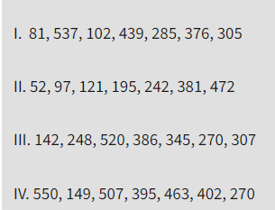
Test Your Knowledge
Q3 The number of ways in which the numbers 1, 2, 3, 4, 5, 6, 7 can be inserted in an empty binary search tree, such that the resulting tree has height 6, is _____________
(A) 2
(B) 4
(C) 64
(D) 32
Answer (C)
Q4 A Binary Search Tree (BST) stores values in the range 37 to 573. Consider the following sequence of keys. Which all of the above sequences list nodes in the order in which we could have encountered them in the search?
(A) II and III only
(B) I and III only
(C) III and IV only (D) III only
Answer: (D)
Notes:
New Courses replaced with New Programmes

Slide 26
REVIEW
A binary search tree(BST) is a special type of binary tree where two properties are obeyed:
The value of the left node is less than the value of the
parent node.
The value of the right node is greater than the value of the parent node.
Notes:
New Courses replaced with New Programmes

Slide 27
References
https://www.youtube.com/watch?v=oSWTXtMglKE
https://www.upgrad.com/blog/5-types-of-binary-tree/
https://www.javatpoint.com/tree
https://www.geeksforgeeks.org/tree-data-structure/
https://www.sanfoundry.com/1000-data-structure-questions-answers/
https://www.tutorialspoint.com/data_structures_algorithms/array_data_structure.htm
https://www.tutorialspoint.com/data_structures_algorithms/tree_data_structure.htm
https://www.simplilearn.com/tutorials/data-structure-tutorial/trees-in-data-structure
https://www.scaler.com/topics/data-structures/tree-data-structure/
Notes:
New Courses replaced with New Programmes

Slide 28
THANK YOU

